Slide 1
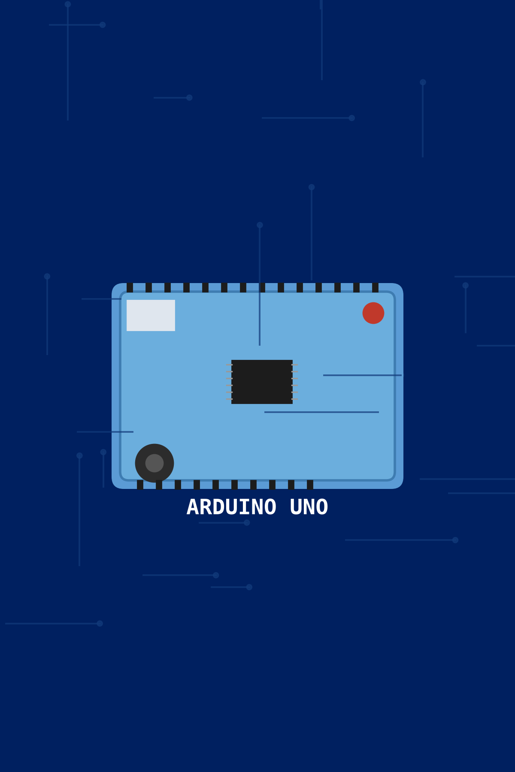
Introduction to Arduino UNO
An open-source electronics platform for prototyping
Widely used in embedded systems, robotics, and IoT
A hands-on workshop on hardware, programming, and sensors

Slide 2
The Amazing Arduino UNO - A Closer Look
Microcontroller
Digital & Analog Pins
USB Port
The brain of the Arduino controlling everything.
Input and output magic for connecting devices.
Connect to your computer to program the board.
Power Jack
Reset Button
Provide energy to power your board.
Start your project fresh anytime.

Slide 3
Arduino UNO Block Diagram – Let's Break It Down!
Power Supply
ATmega328P Microcontroller
Memory
Input/Output
Provides 5V to run the board smoothly.
Stores your programs and data for tasks.
Interfaces to connect sensors and actuators.
The brain controlling all operations and logic.

Slide 4
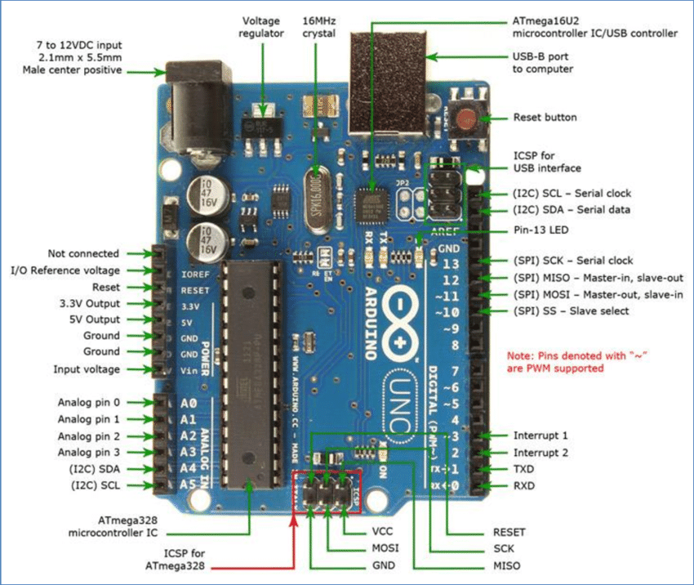
Arduino UNO Detailed Diagram

Slide 5





Sensors – Arduino's Eyes and Ears
Temperature Sensor
Light Sensor
Ultrasonic Sensor
Detects brightness to respond to light changes.
Measures how hot or cold it is around the board.
Uses sound waves to measure distance precisely.
Sound Sensor
Hears sounds and reacts to noise levels.

Slide 6

Actuators – Arduino's Muscles
LEDs
Light up your creations with colorful displays.
Motors
Make things spin, move, or drive around.
Servos
Deliver precise movements for robotic parts.
Buzzer
Create sounds and alarms to catch attention.

Slide 7
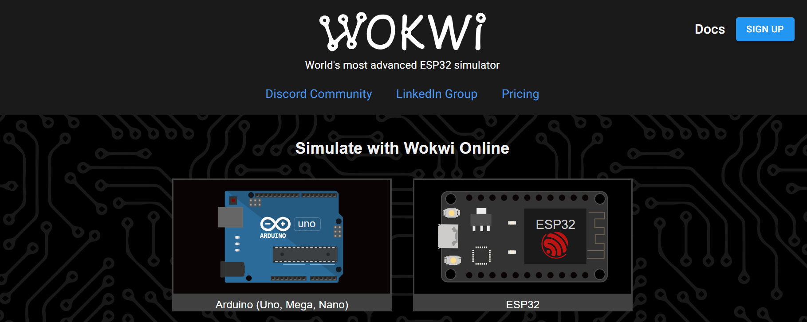
Wokwi Arduino Simulator

Slide 8
Task 1 — LED Blink
Problem Statement
Design a system that blinks an LED every 1 second.
Concepts Covered
GPIO Output
Digital Output
Delay Function
Components
Arduino UNO
LED
220Ω Resistor

Slide 9
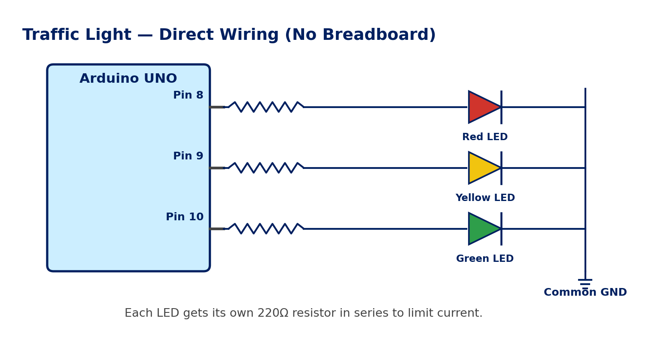
Task 2 —Traffic Light System
Problem Statement
Create an automatic traffic light controller using LEDs.
Concepts Covered
Sequential Logic
Embedded Timing
Multi-output Control
Components
Arduino UNO
Red LED
Yellow LED
Green LED

Slide 10
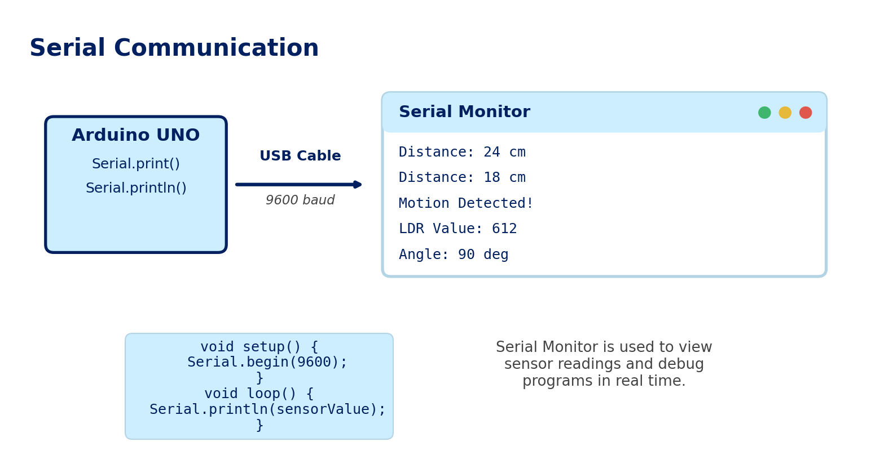
Task 3 —Using the Serial Monitor
Problem Statement
Use the Serial Monitor to send data from the Arduino to your computer, for debugging and viewing sensor values.
Concepts Covered
Serial Communication
Serial.begin() / Serial.print()
Baud Rate
Components
Arduino UNO
USB Cable

Slide 11
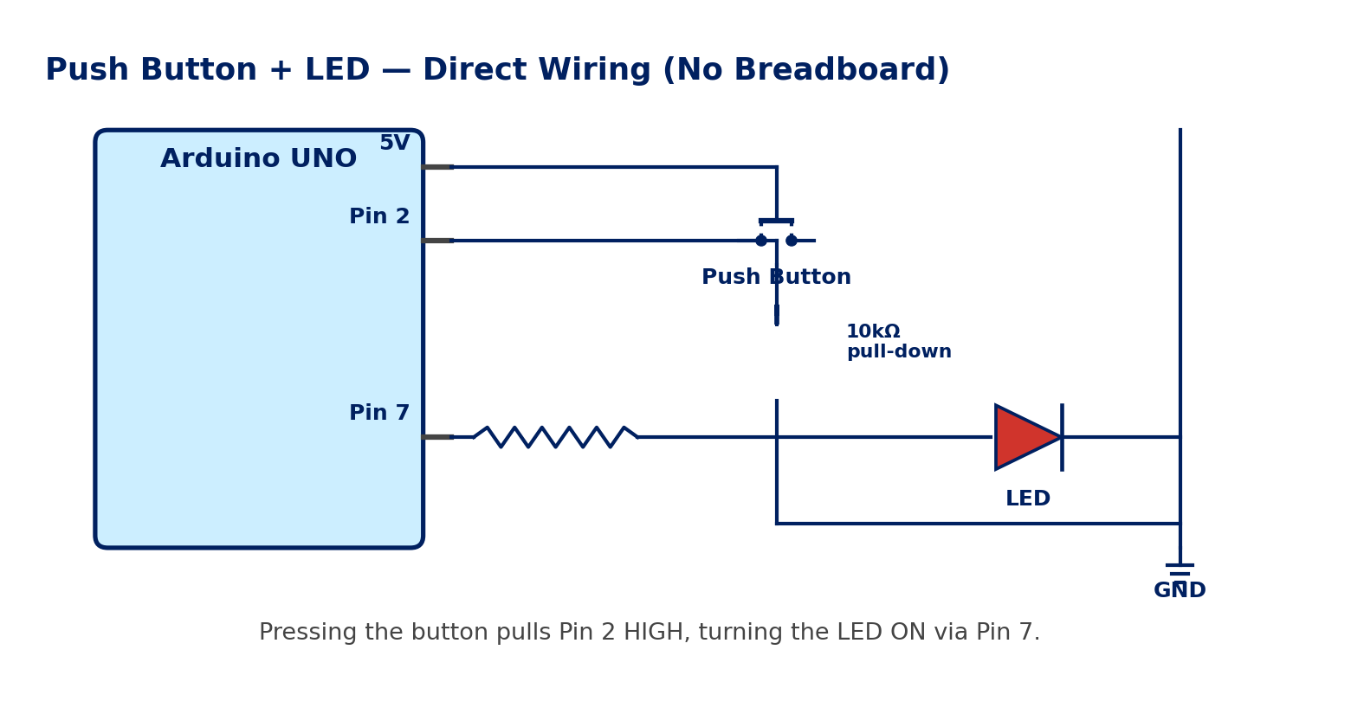
Task 4 —Push Button LED Control
Problem Statement
Turn ON an LED when the push button is pressed.
Concepts Covered
Digital Input
IF Condition
Human Machine Interaction
Components
Arduino UNO
Push Button
LED

Slide 12
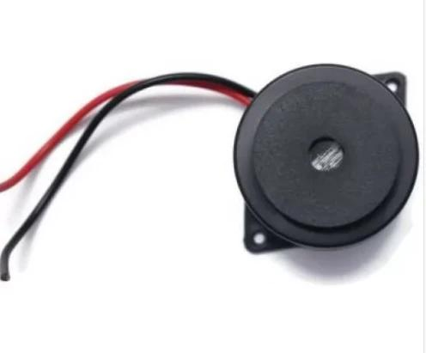
Task 5 —Buzzer Alarm System
Problem Statement
Create a buzzer-based alarm system.
Concepts Covered
Alarm Systems
Digital Output
Embedded Alerts
Components
Arduino UNO
Active Buzzer

Slide 13
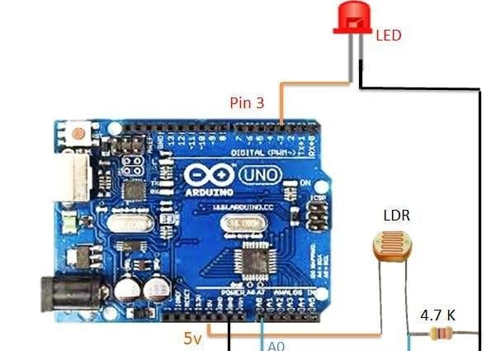
Task 6 —LDR Smart Light System
Problem Statement
Automatically turn ON the LED when the environment becomes dark.
Concepts Covered
Light Sensor
Automation
Conditional Logic
Components
Arduino
UNO LDR
Sensor LED

Slide 14
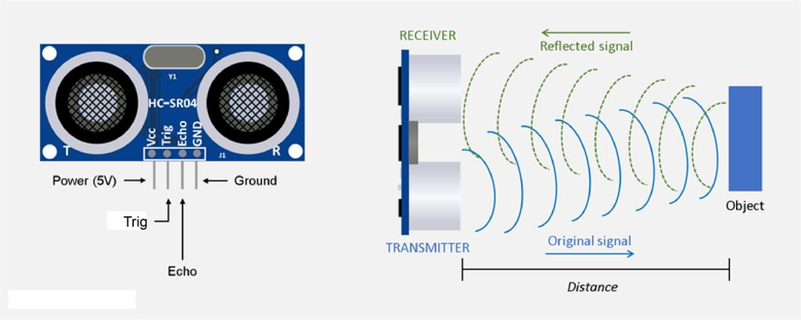
Task 7 —Ultrasonic Sensor: How It Works
Problem Statement
Understand how the HC-SR04 measures distance using sound wave reflection, and calculate the distance from the echo time.
Concepts Covered
Sound Wave Reflection
Time-of-Flight Measurement
Speed of Sound
Components
Arduino UNO
HC-SR04 Ultrasonic Sensor
Distance (cm) = (Duration of Echo pulse × 0.034) ÷ 2

Slide 15
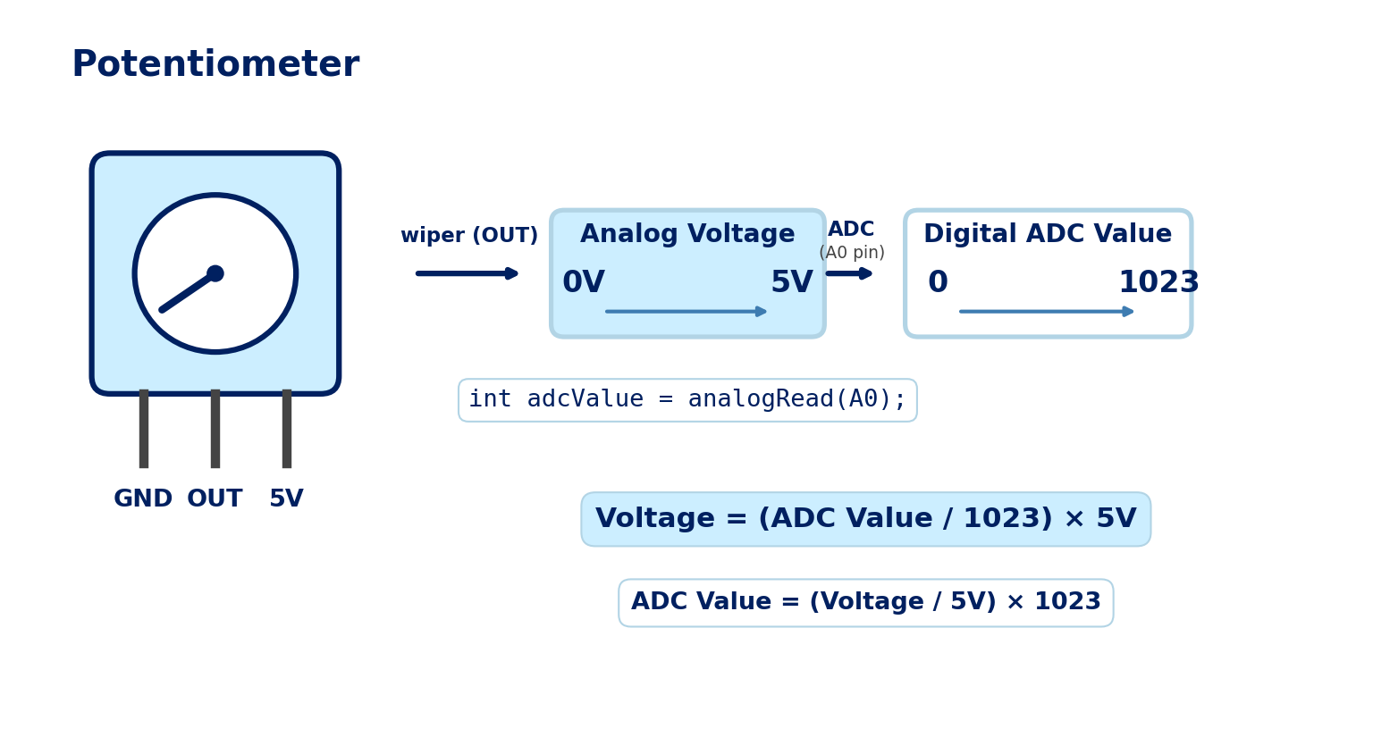
Task 8 —Potentiometer: Reading Analog Voltage
Problem Statement
Turning the potentiometer changes its output voltage (0–5V). The Arduino’s ADC reads this voltage on pin A0 and converts it into a digital value between 0 and 1023.
Concepts Covered
Voltage Divider
Analog-to-Digital Conversion (ADC)
analogRead()
Components
Arduino UNO
10kΩ Potentiometer

Slide 16
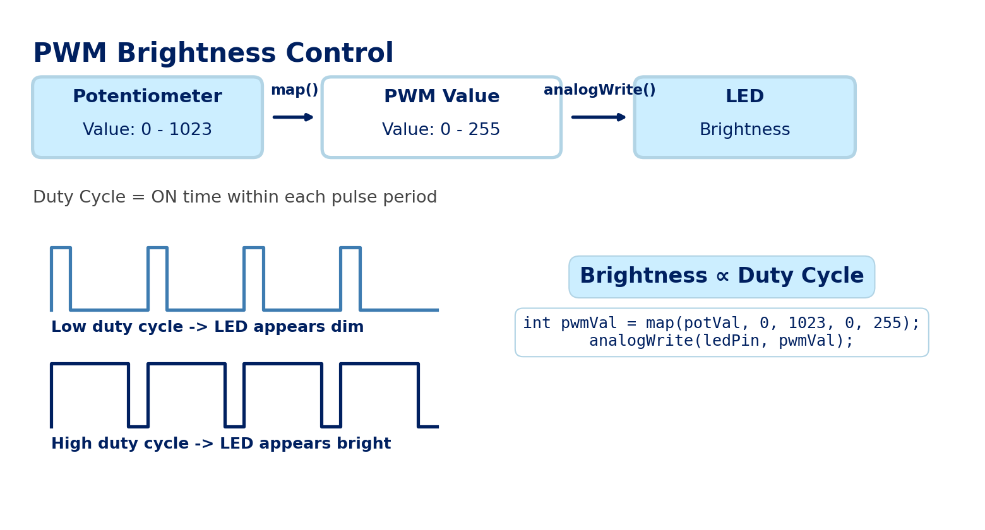
Task 9 —LED Brightness Control using Potentiometer
Problem Statement
Control the brightness of an LED by turning a potentiometer, using PWM output.
Concepts Covered
PWM (Pulse Width Modulation)
map() function
analogWrite()
Components
Arduino UNO
Potentiometer
LED
220Ω Resistor

Slide 17
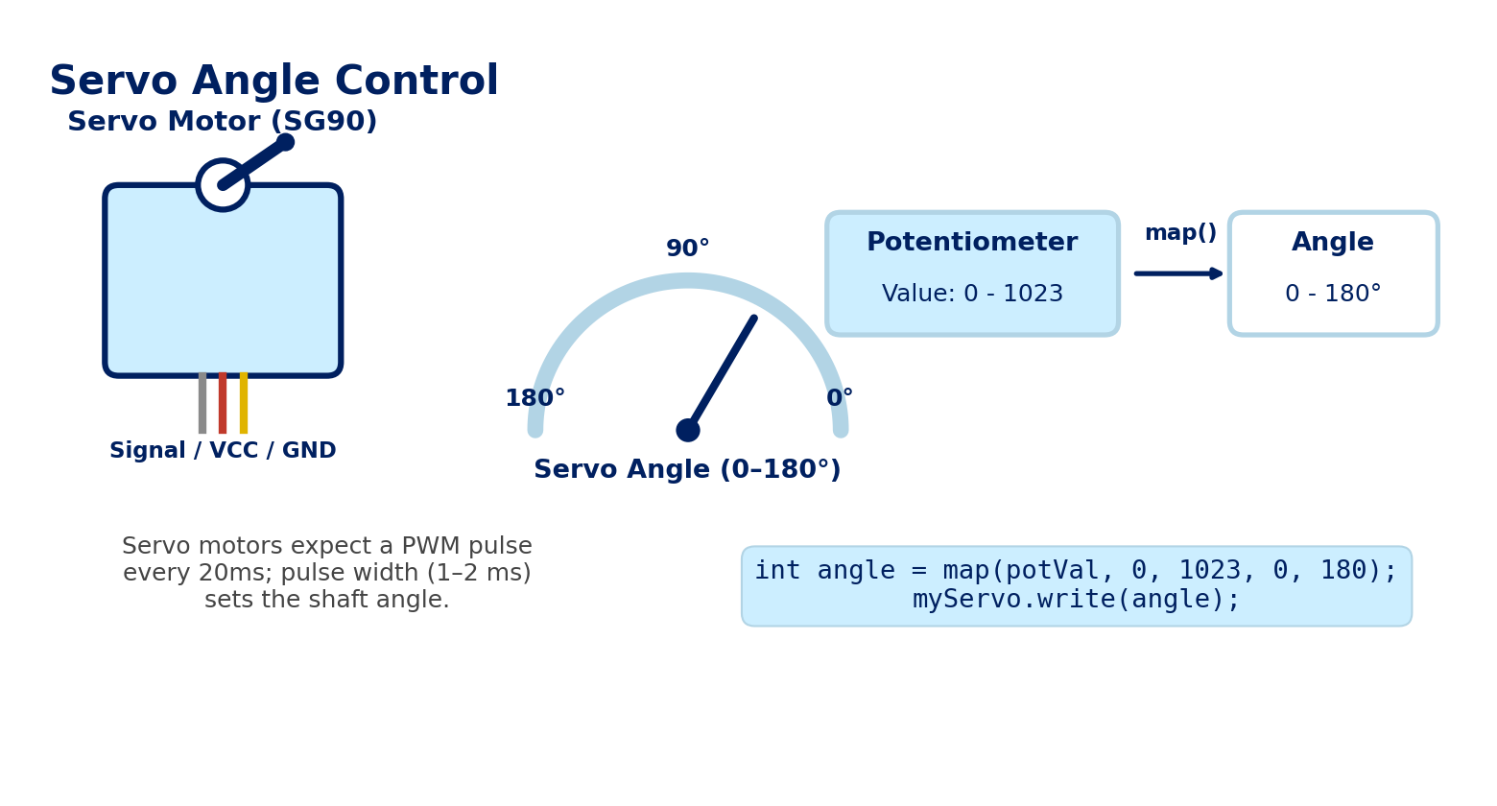
Task 10 —Servo Angle Control using Potentiometer
Problem Statement
Control the angle of a servo motor by turning a potentiometer.
Concepts Covered
Servo Motors
PWM-based Angle Control
map() function
Components
Arduino UNO
Potentiometer
Servo Motor (SG90)

Slide 18
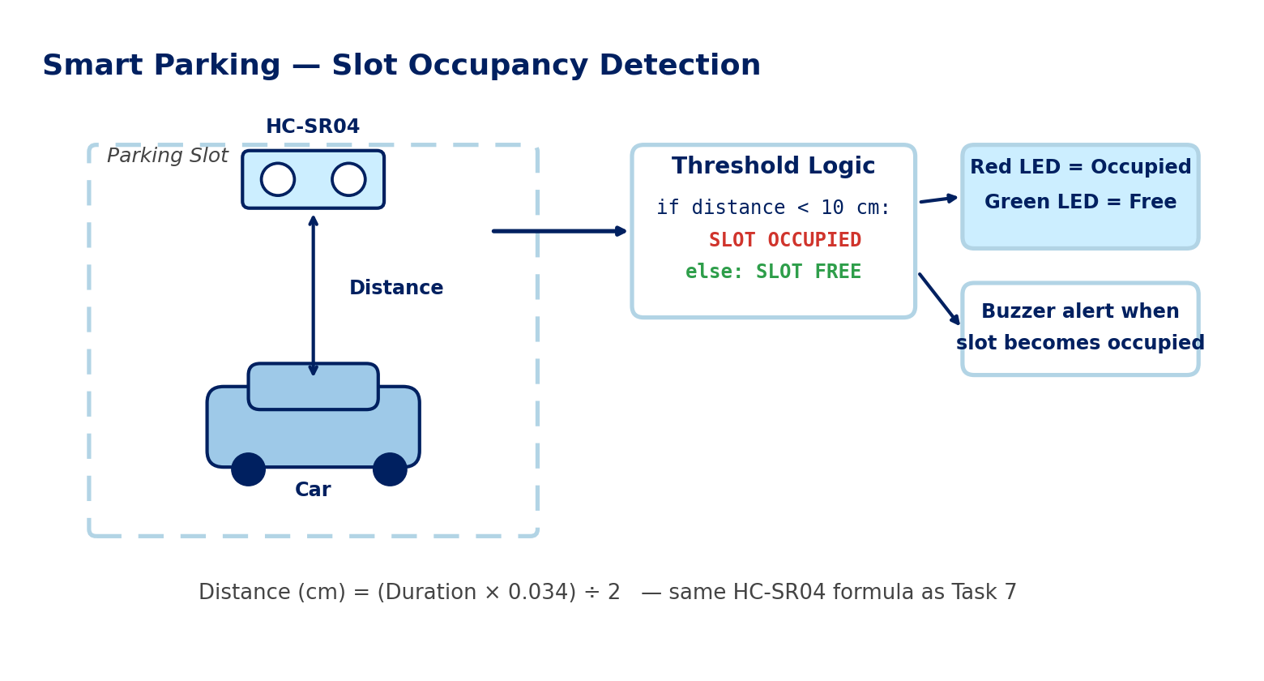
Task 11 —Smart Parking System
Problem Statement
Detect whether a parking slot is occupied or free using an ultrasonic sensor, and indicate status with an LED and buzzer.
Concepts Covered
Distance Thresholding
Conditional Logic
Multi-output Control
Components
Arduino UNO
HC-SR04 Ultrasonic Sensor
LED, Buzzer

Slide 19
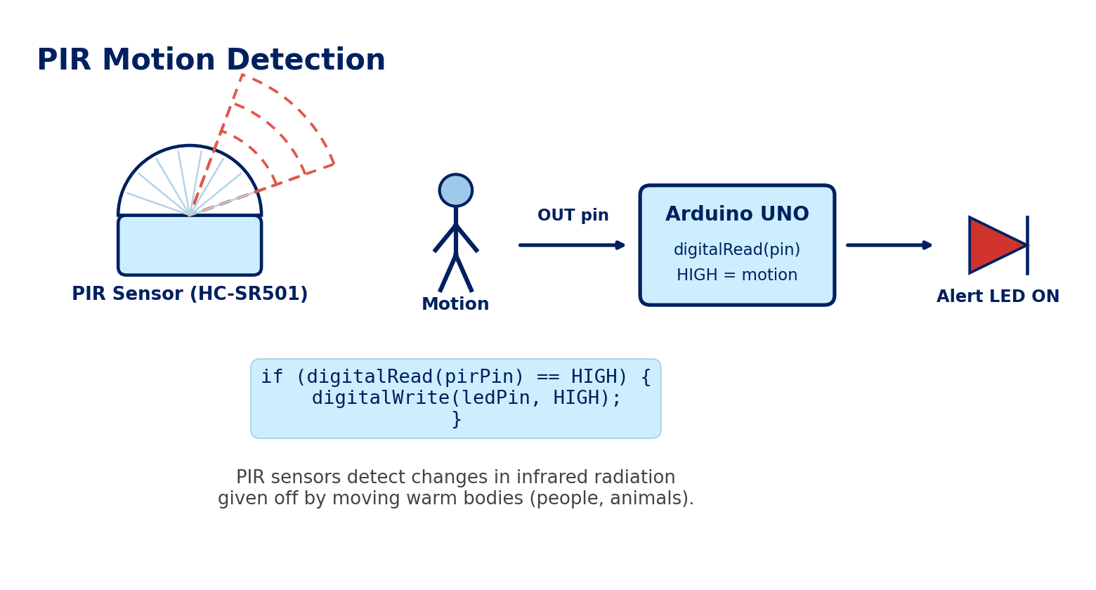
Task 12 —PIR Motion Detector
Problem Statement
Detect motion in a room using a PIR sensor and turn ON an LED whenever movement is sensed.
Concepts Covered
Passive Infrared (PIR) Sensing
Digital Input
Event-triggered Logic
Components
Arduino UNO
PIR Motion Sensor (HC-SR501)
LED

Slide 20
Final Mini Projects
1. Smart Parking System
Using:
Ultrasonic Sensor
LED
Buzzer
2. Automatic Street Light
Using:
LDR Sensor
LED
3. Distance Alert System
Using:
Ultrasonic Sensor
Buzzer

Slide 21

Cool Project Ideas for Students
Remote Controlled Car
Mini Weather Station
Obstacle-Avoiding Robot
LED Blinky Project
Build and drive your own cool RC vehicle.
Measure temperature, humidity, and environment data.
The classic “Hello, World!” of Arduino coding.
A robot that cleverly avoids crashing into stuff.

Slide 22





Fun with Arduino: More Project Ideas
Line-Following Robot
IR sensors track a line while motors steer to follow it.
Bluetooth-Controlled LED Panel
Control LEDs wirelessly from a phone via an HC-05 module.
Temperature Data Logger
Log live LM35 readings to the Serial Monitor over time.
RFID Door Lock
Scan an RFID tag to trigger a servo-driven lock.

Slide 23
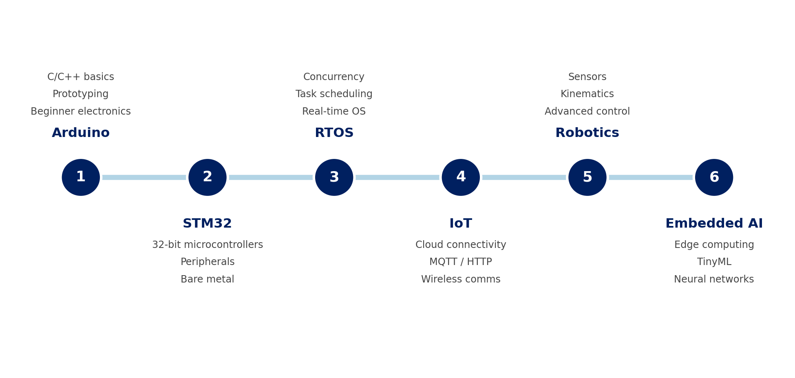
The Future Roadmap
From Maker to Embedded AI Engineer

Slide 24
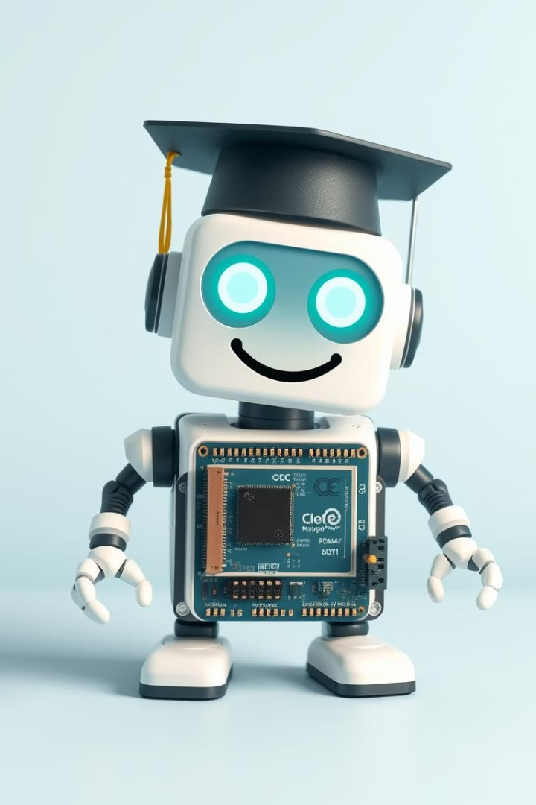
The End! Keep Exploring with Arduino!
Arduino opens doors to endless creative adventures.
Learn, build, and create amazing projects!
Thank you! Any questions?

